Slide 1
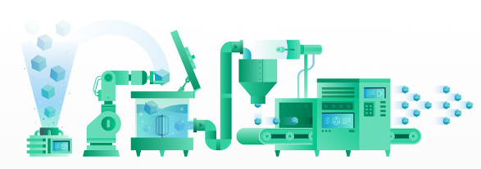
Presentation: CI/CD with terraform in AWS Frederique Retsema

Slide 2
Agenda
17:00 Presentation about this SIG
What objects will be created?
Terraform local (demo)
Terraform in the cloud (1 version at a time)
Terraform in the cloud (multiple versions at the same time)
CodeCommit (incl CodeGuru)
CodeBuild
CodeDeploy
CodePipeline
Own VM, connection details
17:45 Workshop (support until about 21:30)
Terraform local
CodeCommit (incl. CodeGuru)
What objects will be created?
Terraform in the cloud (1 version at a time)
CodeBuild
CodePipeline
Terraform in the cloud (multiple versions at the same time)

Slide 3
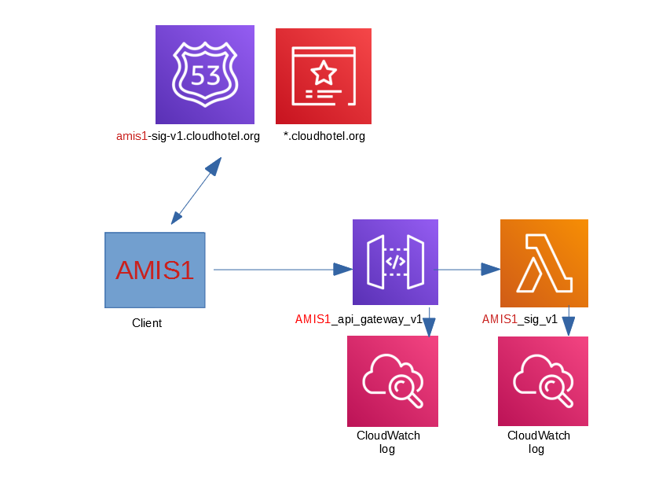
Wat gaan we uitrollen?

Slide 4
Terraform local
Commands:
terraform init -> get libraries
terraform plan -out terraform.tfplans -> show what will be changed
terraform apply terraform.tfplans -> apply changes
terraform destroy -> destroy objects (after question)
Within CI/CD it is useless to show the changes and ask to confirm:
terraform init -> get libraries
terraform apply -auto-approve
terraform destroy -auto-approve
I don't use the following "best practices" from Hashicorp:
No fixed version of the AWS library -> I prefer to always get the newest (vulnerabilities)
All in 1 terraform file -> easyer when there are dependencies

Slide 5
Terraform local
Commands:
terraform init
terraform apply -auto-approve
terraform destroy -auto-approve
Local: terraform will keep track in the directory where the terraform files (*.tf) are
.terraform directory -> f.e.: the AWS library
terraform.tfstate file -> which objecten are enrolled (name, id, etc)
.terraform.tfstate.lock.info file -> lock file with information which command is started by whom
(...and also in other files...)

Slide 6
Terraform in the cloud (one version at a time)
Commando's:
terraform init terraform init
terraform apply -auto-approve terraform destroy -auto-approve
terraform {
backend “s3” {
encrypt = true
bucket = “amis-sig-euw1-bucket” <-- terraform.tfstate bucket
key = “terraform/AMIS1/terraform.tfstate” <-- "directory" + file
dynamodb_table = “AMIS1_state_locking” <-- locking
region = “eu-west-1”
}
}

Slide 7
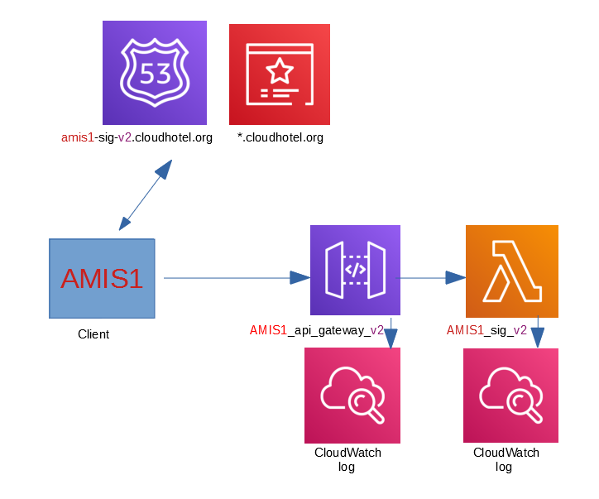
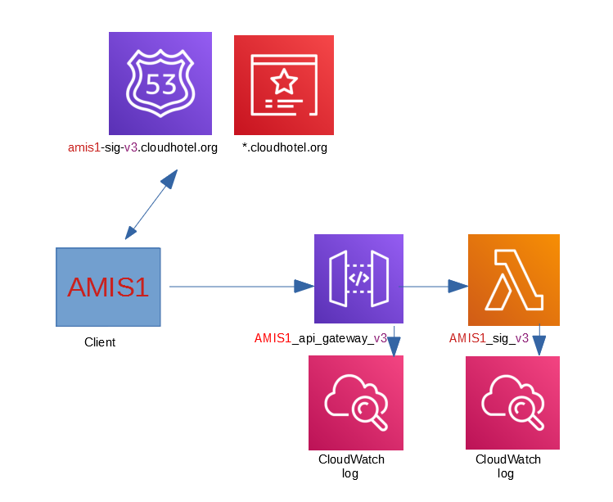
Terraform (multiple versions at a time)
Useful when you want to run multiple versions of the API gateway and Lambdas in parallel to migrate gradually:

Slide 8
Terraform (multiple versions at a time)
Variabelen not allowed in this part of the terraform code:
terraform {
backend “s3” {
encrypt = true
bucket = “amis-sig-euw1-bucket”
key = “terraform/AMIS1/${var.sig_version}/terraform.tfstate” <- mag niet
dynamodb_table = “AMIS1_state_locking”
region = “eu-west-1”
}
}
Solution:
terraform init -backend-config=terraform_s3_directory.cfg
Content terraform_s3_directory.cfg:
key="terraform/AMIS1/v2/terraform.tfstate"

Slide 9
Terraform (multiple versions at the same time)
When the old version should be destroyed, you don't want to change the repo of the newer version (switching back and forth is error prone)
One repo for creation and changes in code
Another repo for destroying old objects (version number will be different):
#################################################################
# VARIABLES
#################################################################
variable "aws_region" { default = "eu-west-1"}
variable "aws_region_abbr" { default = "euw1"}
[…ook alle overige variabelen overnemen...]
#################################################################
# PROVIDERS
#################################################################
provider "aws" {
# access_key = var.aws_access_key
# secret_key = var.aws_secret_key
region = var.aws_region
}
[...ook alle overige gegevens van providers overnemen...]
[...resources en output verwijderen...]
Demo (local)

Slide 10
AWS CodeCommit (code repositories)
Looks a lot like GitHub
CodeCommit (CodeBuild, CodeArtifact, CodeDeploy, CodePipeline) are regional services (!)
Branching and merging works like github
For Java code: use of CodeGuru possible (= automatic comments at a pull request)
CodeCommit is useful when:
- developers are already in AWS
- you want to use serverless functions (Lambda) or notification (SNS) to do "something" with status
changes
It is possible to enforce a minimum number of approvals per change

Slide 11
AWS CodeBuild (build code)
Can be done using a buildspec.yml:
version: 0.2 <- AWS version, not your own version!
phases:
install: <- names of these phases (if used) cannot be
Commands: changed
- echo `date` – install commands <- Replace these echo's by your own
commands. Multiple commands possible (with -)
pre_build:
commands:
- echo `date` – pre_build commands
build:
commands:
- echo `date` – build commands
post_build:
commands:
- echo `date` – post_build commands
artifacts: <- result can be stored in S3 or in
files: <- CodeArtifact (new)
- my_dir/my_file.out
https://docs.aws.amazon.com/codebuild/latest/userguide/build-spec-ref.html

Slide 12
AWS CodeBuild (build code)
CodeBuild can be connected with CodeCommit and Github
Environment variables possible

Slide 13
AWS CodeDeploy (enroll software)
Possible for Lambda (which should be there before enrollment by CodeDeploy),
EC2 (virtual machines) and ECS (containers in AWS)
Uses appspec.yml (comparable with buildspec.yml)
Both in-place enrollment as blue/green deployment possible
Can automatically roll back a release when the deployment fails
Hard to combine with terraform API Gateways -> therefore out-of-scope for this SIG

Slide 14
AWS CodePipeline
Combines CodeCommit, CodeBuild, CodeDeploy
Uses hooks in CodeCommit, GitHub, CodeBuild, CodeDeploy
Combination of CodeCommit, CodeBuild, CodeDeploy in CodePipeline is very simple
It is possible to waiting for the approval of a user (not in this SIG, is not that difficult to do)

Slide 15
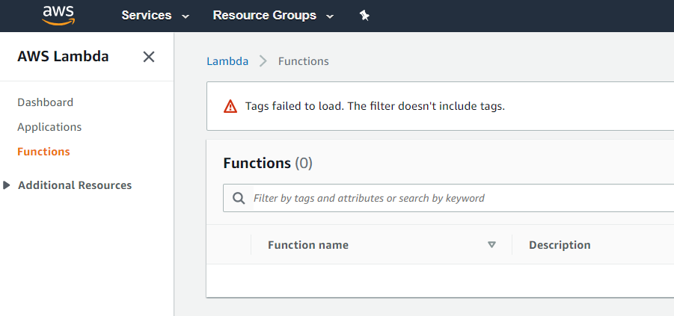
SIG Play environment
Ignore the next 2 errors/warnings:
Lambda:

Slide 16
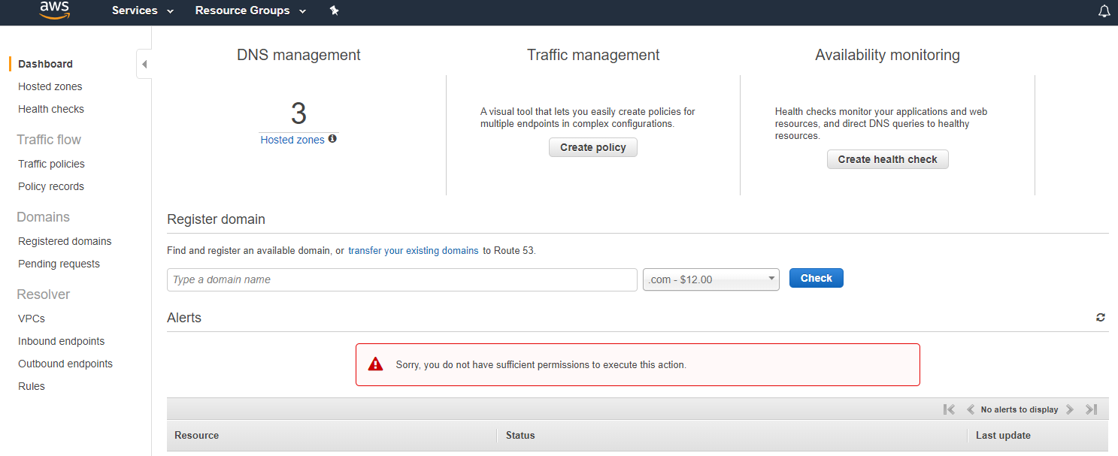
SIG Play environment
Ignore the next 2 errors/warnings:
Route 53:

Slide 17
SIG Play environment
You will find a description how to delete objects by hand in the documentation on the last page.
The play environment can be used until next Sunday at 20:00
The virtual machine might be stopped (will be stopped every evening at 0:00 CET), you might have to start it manually (demo)
When this is the case, you will have another IP addres than before, the data on the VM is however the same as on the moment that you logged off.
Questions after 21:30 tonight via frederique.retsema@amis.nl

Slide 18
SIG Play environment in your own AWS account
You do need an own Route53 (DNS-)domain
Costs: please mind: CodeCommit is charged per user per month. FreeTier has 5 free users per month. When you destroy all objects and later create them again, you will use a new user (even when this new user has the same name/permissions). You might consider not destroying the environment each evening (just stop the VM) when you want to continue in the morning?

Slide 19
SIG Play environment in your own AWS account
Download and install vagrant, Virtual Box and git
git clone https://github.com/FrederiqueRetsema/AMIS-Sig-AWS-CICD
cd AMIS-Sig-AWS-CICD/vagrant <-- in this directory: README.md and faq.pdf
vagrant up
vagrant ssh
./init-all.sh
cd ~
./destroy-all.sh
exit
vagrant halt (to stop the VM on your laptop, or vagrant destroy to get rid of the VM)

Slide 20
Need help after 21:30 this evening?
E-mail: frederique.retsema@amis.nl

